Slide 1
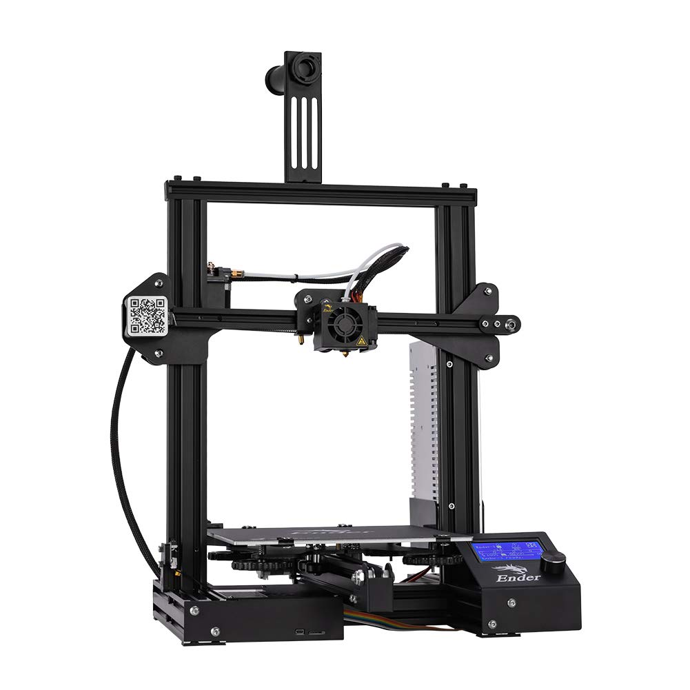

Team 21: 3D Printer and Application Interface
Bi-Weekly Update 5 Cody Hutchison Steven Liu Abigail Morar Sponsor: Dalton Cyr TA: Milenka Gamero
Notes:
Michelle

Slide 2
Project Summary
Current 3D printers require the user to manually upload a G-code file by an external storage device and initiate the printing process via controls on the printer
The new 3D printer and Application will allow the uploading, controlling, and initiation of printing from anywhere with internet access. The print time will also be within 10% of the Ender 3 printing time while also attempting to speed up the Z-axis movement speed.
Notes:
Kyle

Slide 3
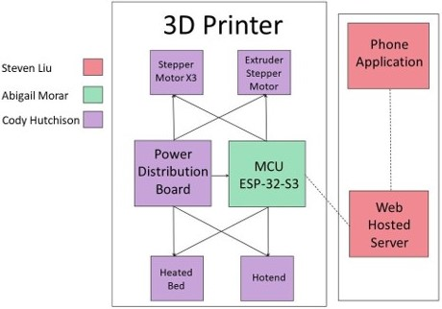
Project/Subsystem Overview
Notes:
Eric

Slide 4
Project Changes for 404
Everything is still on track from what was planned in 403.
As of now, changes are mostly geared towards fixing bugs in the subsystems for full integration, and dealing with whatever problems may arise from that.
Notes:
Eric

Slide 5
Project Timeline
Validate System
Finish Subsystems
Integrate Subsystems
Final Presentation
Final Demo
February 15
March 15
March 29
April 10
April 24
Notes:
January 30th - February 5th
Ensure all parts required to complete PCBs are on hand or order more
Start populating PCB if they have arrived
February 6th - 12th
Have PCB populated and validate

Slide 6
Electrical Subsystem
Cody Hutchison
Accomplishments since last update 24 hrs of effort | Ongoing progress/problems and plans until the next presentation
 | Integrate PCB with MCU Build printer case for PCBs Solder jumper wires and modify board for the axis switches

Slide 7
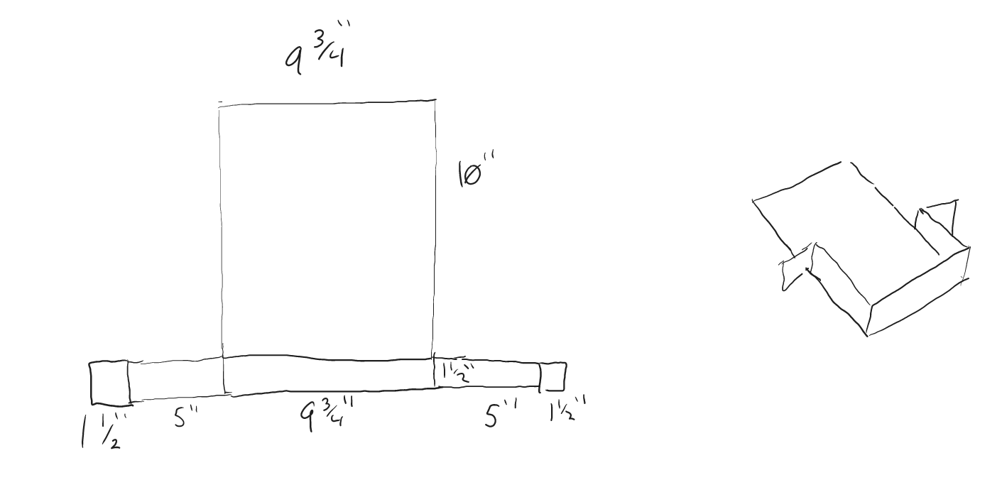
Electrical Subsystem
Cody Hutchison

Slide 8
Application and Server Subsystem
Steven Liu
Accomplishments since last update 15 hrs of effort | Ongoing progress/problems and plans until the next presentation
Application tuning Added logo and splash screen | Look for possible improvements Finish poster Update Final Report

Slide 9
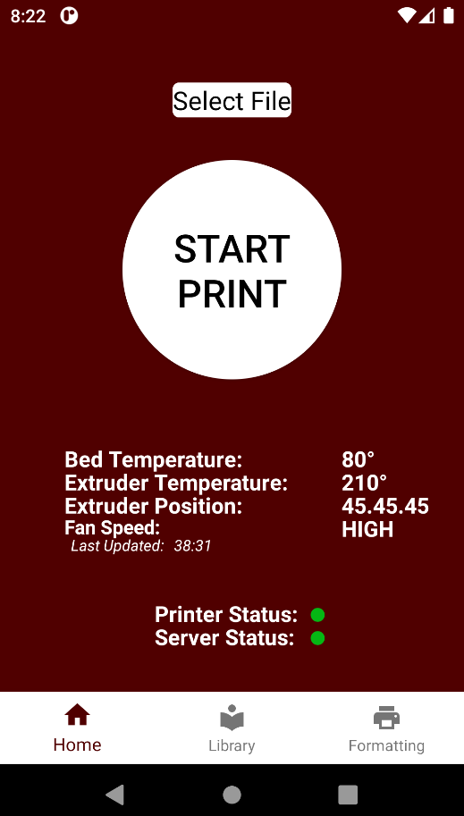
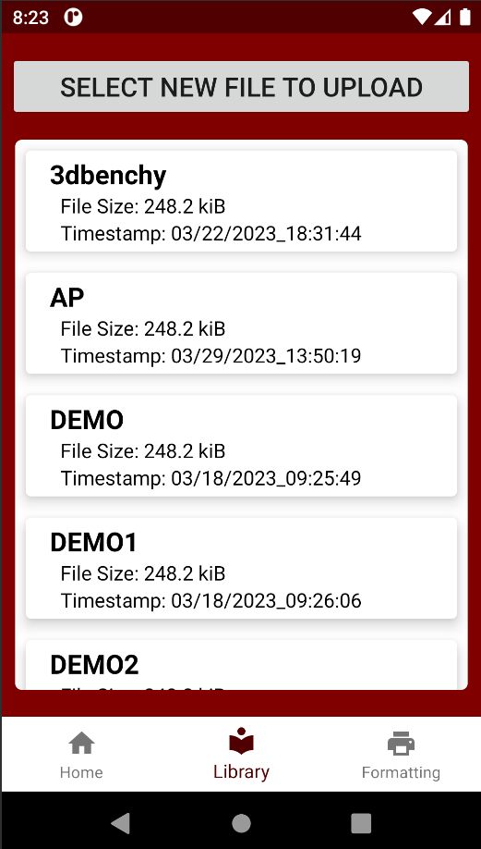
Application and Server Subsystem
Steven Liu

Slide 10
Microcontroller Programming Subsystem
Abigail Morar
Accomplishments since last update 20 hrs of effort | Ongoing progress/problems and plans until the next presentation
- Heated bed reading/writing and maintaining temperature correctly - Found steps per full revolution for each motor - Found mm per full revolution and steps/mm | - Measure/calculate constants for hotend - Verify all motor speeds for print and extruding amount per mm with filament - Updating changes to main code - Tweaking for accuracy

Slide 11
Microcontroller Programming Subsystem
Abigail Morar

Slide 12
Integration
Accomplishments since last update | Ongoing progress/problems and plans until the next presentation
Continue integration between MCU and Electrical Subsystem | Validate App/Server and MCU integration Validate MCU and Electrical Subsystem integration

Slide 13
Parts Ordering Status
No parts on order or required at the moment
Notes:
Michelle

Slide 14
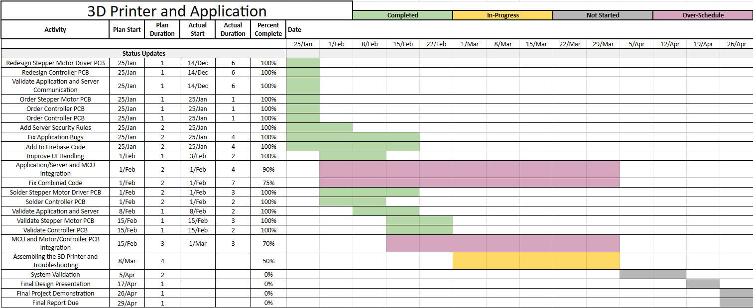
Execution Plan
Notes:
Michelle

Slide 15
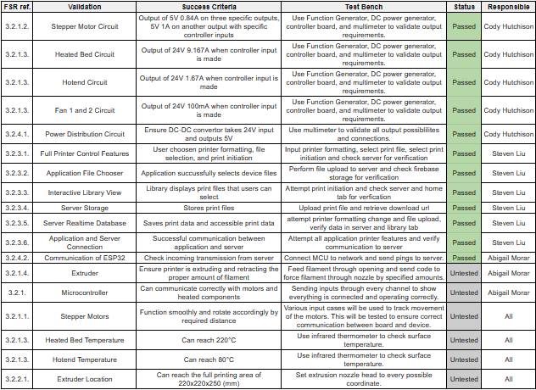
Validation Plan
Notes:
Michelle

Slide 16
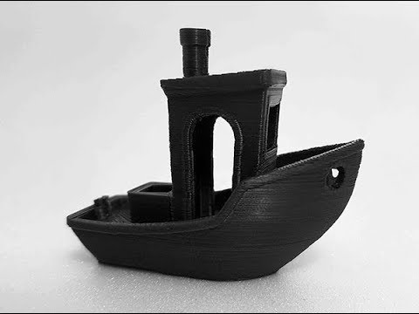
Questions? Comments?
Thank You

